Slide 1

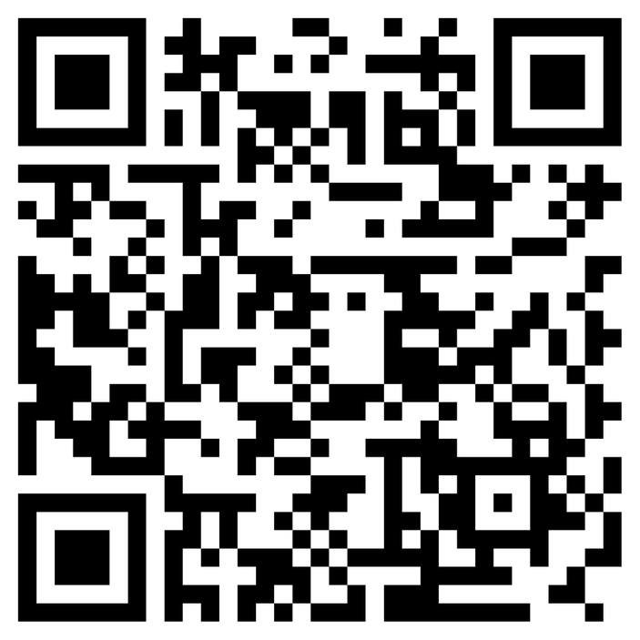


2023
Celebrating Diversity and Tackling Discrimination in our workforce – Session for NCL Educators
Hosted by NCL Faculty of Educators in partnership with NCL Training Hub. Thanks to colleagues from DIMAH (Diversity in Medicine and Healthcare) and the Medical Schools Council (MSC)EDI Alliance for resources
Training Hub Faculty Programme Directors
Notes:
Speaker to introduce themselves and the session

Slide 2

Learning Objectives
By the end of the session you will have:
An awareness of the impact of racial discrimination on peers and colleagues through an intersectional lens
Understood what Differential Attainment is and consider what we do to address it
Considered and understood the terms - unconscious bias, prejudice, discrimination and microaggressions, privilege and disadvantage
Practiced language and approaches to deal with prejudice and discrimination and be an ally
Notes:
45 min session, small group work

Slide 3
Discussion Guidelines
Safe space – share only what you feel comfortable sharing
Confidentiality
Assumption of good intention
Respect the options of others – even if you don't agree
No right or wrong answers
Open mind
Challenge ideas/not people
Monitoring input – make sure everyone gets a voice and no one monopolises the conversation/discussion
Learning together in a supportive environment
https://internal.kcl.ac.uk/ioppn/diversity/Race-Equality/race-discussion-toolkit
Notes:
Brave Spaces as maintaining Psychological Safety tricky sometimes, I don't know what you bring. We are aware this may be uncomfortable, difficult at times and bring things up for you personally or professionally. Look after yourselves, I am here afterwards or via email or step out if you need to.
We will all get it wrong, it’s ok to apologise, learn and try again.
We may ask you to park certain issues if this is not the forum to discuss it and speak to you 1:1 after the session if you need to
We need names and an agreement not to share personal details of sensitive material/stories shared here
We need to know who you are and we need an identifiable name or we may need to remove you from this webinar
You can use the chat function and one of us will monitor it and raise your hand too!

Slide 4
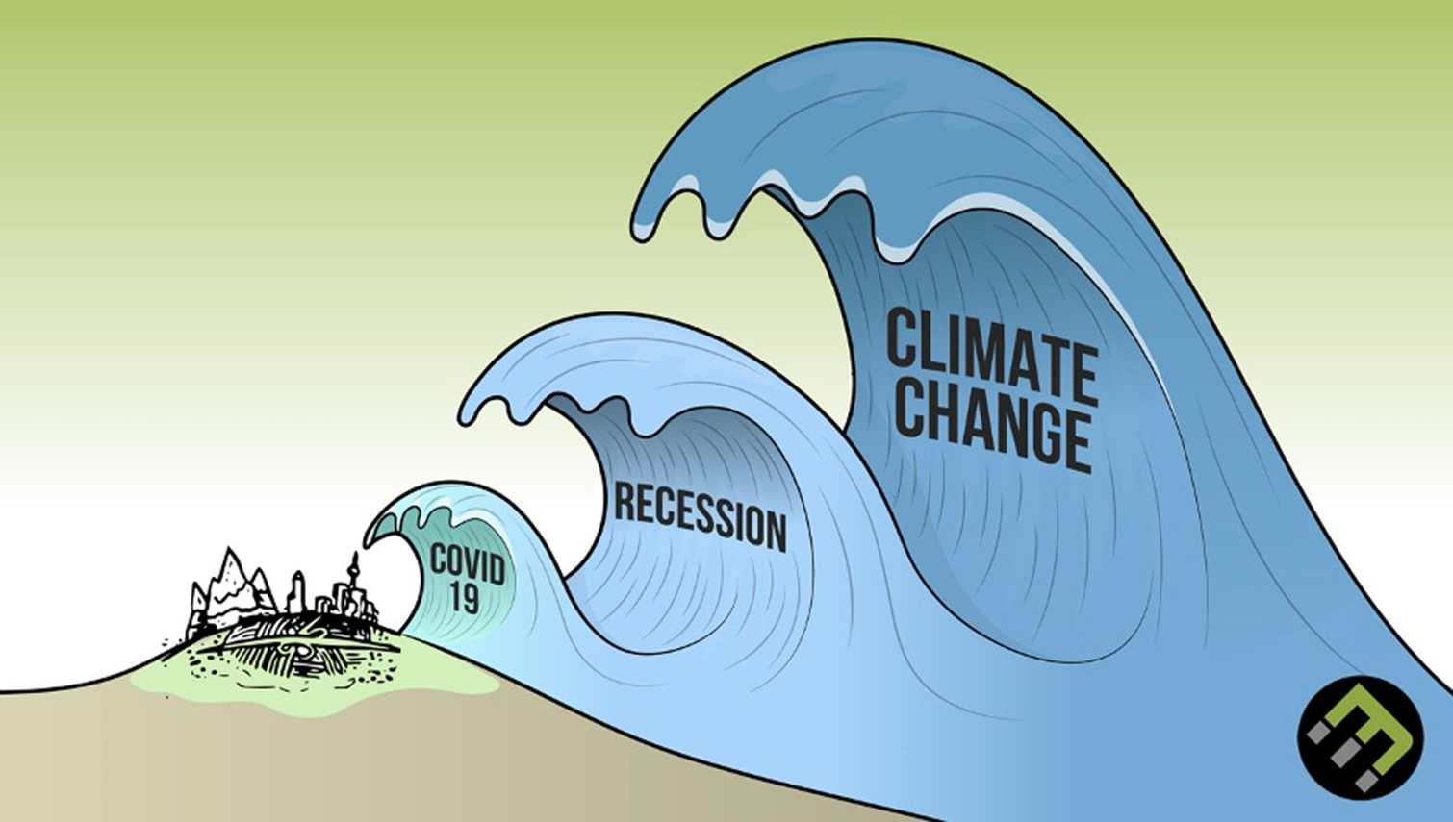
A Triple Pandemic
Notes:
Covid19, Recession and the climate crisis are all public health issues we as educators need to tackle. Who do ALL these issues affect more, minority ethnic staff and people and those from lower socioeconomic demographics e.g. less access to greener spaces, exposed to more pollution if you are deprived, more likely to be black or brown - so focus of the talk today is racial discrimination for our staff
Reference for this pic?

Slide 5
Racism in Healthcare
Pan London Primary Care WRES launched March 2023
Ethnicity was the most common characteristic associated with harassment
and discrimination in primary care, above gender, age, religion, and disability.
1 in 3 of those surveyed reported racial discrimination or harassment from patients in the past 12 months (30%) and about 1 in 5 from staff they worked with (18%). The proportions were similar amongst GP partners and salaried GPs, nursing, and administrative staff.
Notes:
Pan London Primary Care WRES (Workforce Race Equality Survey) March 2022
1,000 colleagues

Slide 6
Protected Characteristics
The Equality Act (2010) protects these categories:
Age
Disability
Gender reassignment
Marriage and civil partnership
Pregnancy and maternity
Race
Religion or belief
Sex
Sexual orientation
Notes:
Ask the group to guess these categories type in chat of call out all nine of these protected characteristics

Slide 7



Glossary
Unconscious Bias prejudice in favour of or against one thing, person or group compared with another. It can manifest in how we judge and evaluate others, or how we act towards members of different groups. We all have bias and stereotypes we cannot avoid it.
Prejudice is pre-judgement about another person based on the social group(s) to which that person belongs. Consists of thoughts and feelings, including stereotypes, attitudes and generalizations that are based on little or no experience and then projected onto everyone from that group.
Discrimination is action based on prejudice. These actions include ignoring, exclusion, threats, ridicule, slander and violence. Discrimination may be personal maybe internalised racism/misogyny/colourism, interpersonal, When a racial group’s collective prejudice is backed by legal authority and institutional control it is transformed into institutional and structural racism. Racism is a structure, not an event.
Micro aggressions have been defined as brief and common daily verbal, behavioural, and environmental communications, whether intentional or unintentional, that transmit hostile, derogatory, or negative messages to a target person because they belong to a stigmatized group. Can result in othering, a sense of not belonging.
Notes:
Working on the basis you all understand these terms – we can go through briefly to begin with if helpful. There is also a brilliant short e-module on the RCGP website (you don't need to be a member) that covers these on Allyship with examples https://elearning.rcgp.org.uk/course/view.php?id=559
All humans have bias/stereotypes we cannot avoid it. https://www.unconsciousbiasproject.org/resources/explain-unconscious-bias
Discrimination may be personal maybe internalised racism/misogyny/colourism, interpersonal, When a racial group’s collective prejudice is backed by legal authority and institutional control it is transformed into institutional and structural racism. Racism is a structure, not an event. It is not enough not to discriminate - we need to be anti-discriminatory and anti-racist.
Microaggressions - Common example where are you from? What’s the intention behind it? How do you determine the intention? Often subtle – acid rain/lots of little cuts – easier to spot overt racism
Sue DW, Capodilupo CM, Torino GC, Bucceri JM, Holder AM, Nadal KL, Esquilin M (2007). "Racial microaggressions in everyday life: implications for clinical practice". The American Psychologist. 62 (4): 271–86. doi:10.1037/0003-066x.62.4.271. PMID 17516773.

Slide 8
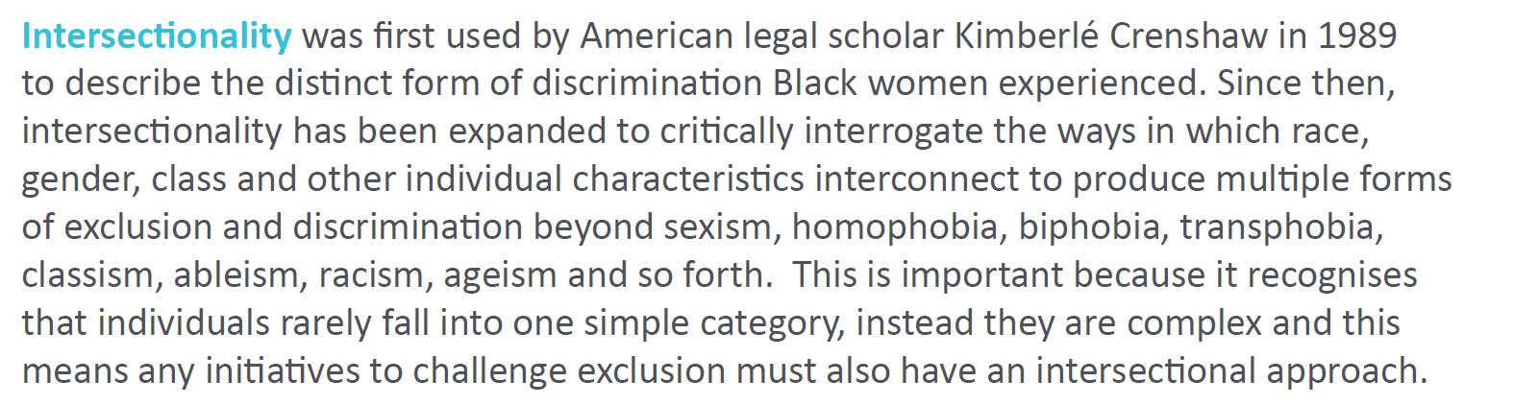
Intersectionality
Notes:
Kimberley Crenshaw definition of Intersectionality first use in black women.
We want our colleagues and supervisees to be able to bring their whole selves to work and recognise that there may be many forms of exclusion based on discrimination.

Slide 9
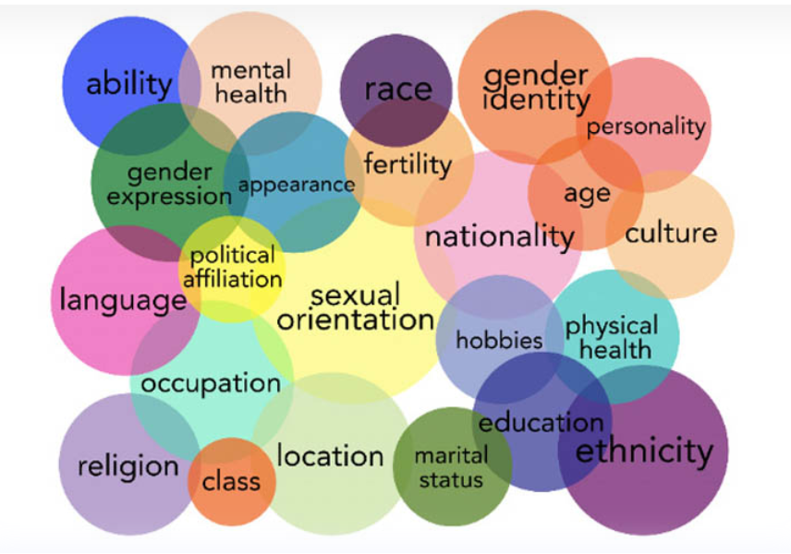
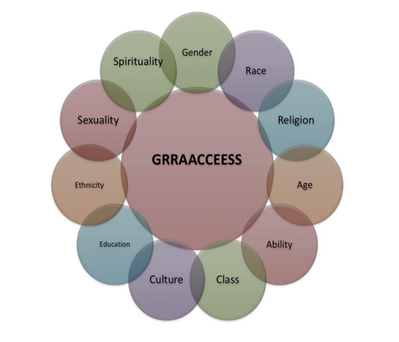
Intersectionality - Exercise 1
https://diversity-inclusion-speakers.com/news/top-10-lists/intersectionality-what-it-is-who-to-book/
Notes:
Use this of SOCIAL GGRRAAACCEEESSS model (John Burhnam, Alison Roper-Hall and colleagues – 1992). The importance of feeling safe and bringing our whole selves to work, becomes clearer when we talk about our identity and the identity of others. Social graces is a framework which helps us to think about more broadly about identity and power. Alison Roper-Hall and John Burnham came up with the Social GRACES in the 1990s. They thought it was a disgrace that many clinicians did not think broadly about identity and power differences
To consider our own privileges (situational advantages) and disadvantages – let’s do this 4 mins in pairs, only share what you feel comfortable with – facilitator(s) to go first with examples. Specific examples don’t need to be shared themes, how easy or not was it, have you every thought about your own privileges e.g. able bodied, class, colour

Slide 10
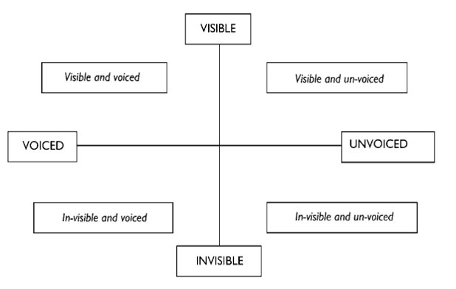

Intersectionality - Exercise 1
https://diversity-inclusion-speakers.com/news/top-10-lists/intersectionality-what-it-is-who-to-book/
Notes:
Whose voices are heard and seen in your organisations, practices? Who is included and who maybe excluded?
Some are visible and spoken about and others, particularly when it feels like a unsafe environment, may be hidden and unspoken.

Slide 11

Sexual Orientation and Gender Identity
Many LGBQT+ people do not feel comfortable to be open about their sexuality and gender in the workplace.
Homophobic and bi-phobic views still exist within medicine and transphobia more widely recognised as an issue.
“Low level” microaggressions, jokes and banter continue to be widely experienced.
Discrimination and harassment persist and are common. Most incidents go unreported.
Notes:
The Stonewall “LGBT In Britain – University Report” showed that 42% of LGBTQIA+ students hid their identity at university for fear of discrimination.

Slide 12
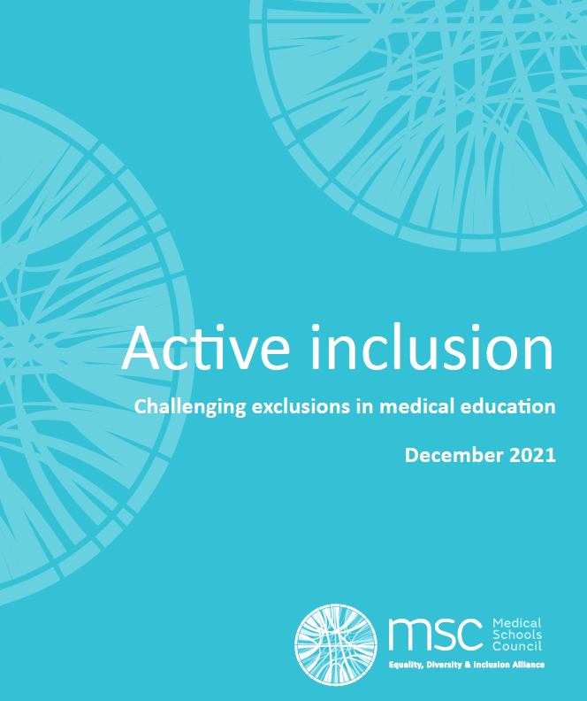
Active Inclusions – Challenging Exclusions
The National Union of Students (2018) found one in three Muslim students experienced some form of abuse or crime at their place of study, and that female and LGBTQIA+ Muslim students were even more vulnerable.
The experiences of disabled students in higher education - many continue to feel excluded within teaching, learning and social environments, in addition to increased bureaucratic and financial pressures.
Notes:
?? Likely to be similar data in Primary Care

Slide 13
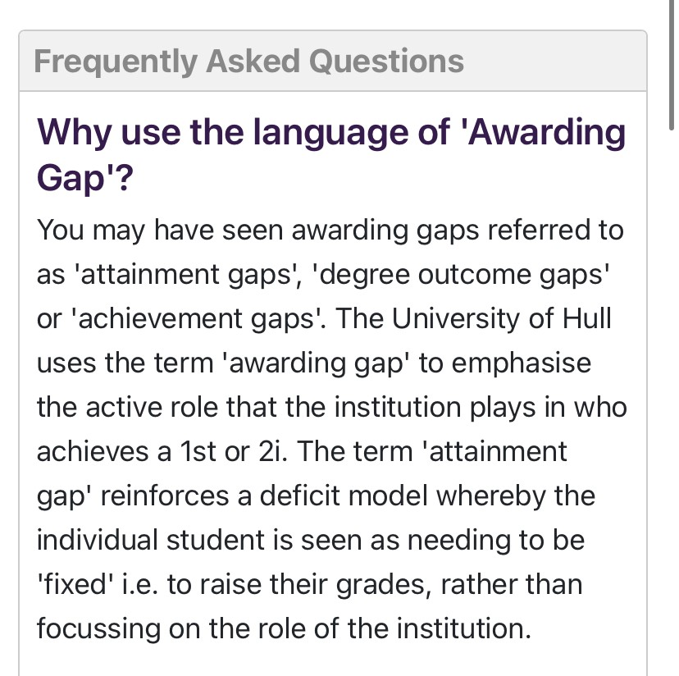
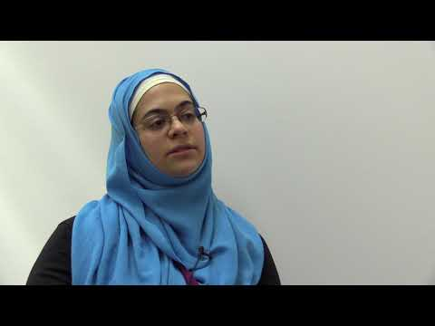
What is Differential Attainment?
Notes:
1 min video in the link if you prefer to use that instead
1st pic is from the GMC
2nd pic Uni of Hull awarding gap – focus on institutions rather than individuals

Slide 14
GMC Report Tacking Disadvantage in Medical Education – Postgraduate Outcomes by Ethnicity
Disparities in exam pass rates - Speciality exams 79% white trainees, 68% Asian, 62% Black UK grads
These disparities compounded by socio-economic status
Higher proportion of white trainees offered posts than those from other ethnic minorities
Notes:
Often people think just of international medical graduates but disparities for those born here too

Slide 15
Improve the learning environment
Improve teacher-learner relationships – equitable access and opportunities
01
Encourage mixed peer relationships
02
Value Diversity - not tolerating racism
03
Notes:
As primary care educators we can focus on all three of these areas.
To address DA – move away from the deficit model approach – system levels approaches/institutional responsibility. Stop blaming learners - poor fit to research findings, stigmatises learners, diverts resources away from solutions
Diversity, fair hiring processes, reverse mentoring, in exams?
BMA Charter against Racial Harassment
Monitoring – WRES
Policies
Woolf Katherine, Potts Henry W W, McManus I C. Ethnicity and academic performance in UK trained doctors and medical students: systematic review and meta-analysis BMJ 2011; 342 :d901
McManus, I.C., Dewberry, C., Nicholson, S. et al. The UKCAT-12 study: educational attainment, aptitude test performance, demographic and socio-economic contextual factors as predictors of first year outcome in a cross-sectional collaborative study of 12 UK medical schools. BMC Med 11, 244 (2013). https://doi.org/10.1186/1741-7015-11-244

Slide 16

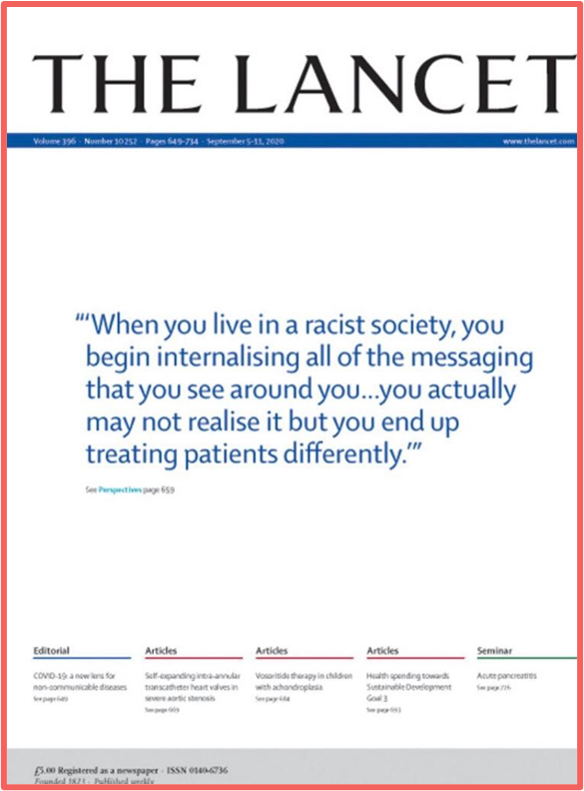
Exercise 2 – Let’s work through some scenarios
Notes:
Let’s practice speaking up, what do we say and how?

Slide 17
Scenarios and Speaking Up
A patient says they don’t want to see the black Dr/nurse at your practice and wishes to see another Dr/nurse. She is the only Dr/nurse at your practice this afternoon. If you are not white yourself the patient also keeps asking you “where are you from?” What would you do or say? Do you have any local policies to support this?
A senior colleague keeps mispronouncing a new Pharmacy student’s name & in the end just ignores her. The student asks you if you have noticed, it is really upsetting her. What do you say to the Pharmacy Student? How would you tackle this with the senior colleague if you think this is appropriate?
You ask a colleague how they are before your shift ends. They complains about “these patients coming from abroad to get free treatment on the NHS!” They mention the patient has asked to put his name down at Johnny which is different to his given name on his documents. How would you respond? How would you respond? What would you say next?
Notes:
4min Being an Ally video if you click Speaking up
Think about the language you might use, what would you actually say?
A 42 year old black male patient calls to ask for a medical certificate for a flare of his OA hip (secondary to polio as a child, awaiting another Orthopaedic review). He mentions in passing not being believed about his pain and racism in previous workplaces. What do you need to consider and discuss with him?
A Pakistani female patient at your practice who has a borderline personality disorder (PD) diagnosis and not worked most of her adult life, is seeing a coach the GP referred her. She is applying for jobs. She asks you if it’s possible not to put her PD diagnosis down on the application form. What are the issues for this patent and what questions and answers do you need to help support her?
Ask why is this discrimination? Remember the GMC guidance – Duty of Care
Things to consider - In rare circumstances, the trust between you and a patient may break down, for example, if the patient has:
been violent, threatening or abusive to you or a colleague²
stolen from you or the premises
persistently acted inconsiderately or unreasonably
made a sexual advance to you.
2. Microaggression, believe your colleague the student and the impact on her. Is your senior colleague aware of what they are doing? Can they address this (keep practicing), who is the right person to have a word with them?
3. Prejudice or discrimination

Slide 18
How would you respond to this?
Step 1: Reiterate. Restate what you heard. This step enables you to reflect on what you have heard as opposed to what you think you may have heard. Repeating what you have heard limits miscommunication and misinformation.
Step 2: Contemplate. Count to 10 before responding. Gives you time to think about your response / what you want to say. May also help to diffuse conflict
Step 3: Breathe. We often hold our breath in difficult situations, so take a few breaths to help to settle emotions and thoughts
Step 4: Communicate. Speak clearly and thoughtfully. Focus on the negative statement rather than the person who said it. Make it clear that you disagree with the statement
www.tolerance.org

Slide 19

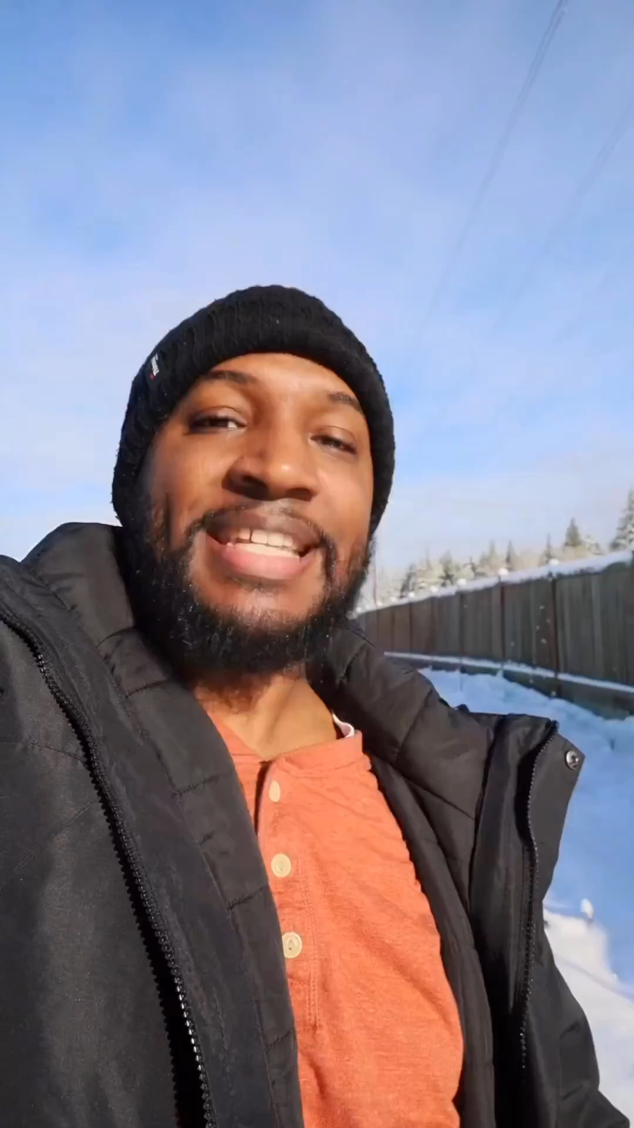
Finding the right words and phrases
“What do you think he would think if he heard you calling him that"?
"That comment has made me feel very uncomfortable"
"It is not funny to me; it is a racist comment"
"I find what you just said offensive, can we talk about it please"
"Racial jokes are unacceptable"
"I have no idea if you realise the impact of those words"
That sounds racist to me; if you continue to talk like that, I will have to leave"
"We respect all people and do not tolerate those words or phrases"
Notes:
Click on the image to play the video…
Make the invisible, visible.
Sometimes the offender is not aware that they have said something offensive, so it needs to be made visible
Educate the offender. Focus on the impact of what has been said rather than the intention. When you focus on the intention you can lose the argument
Disarm the microaggression - Immediately steer the conversation, joke or remark to being very clear that this is offensive is modelling good behaviour to others that may be present. The other person that made the comment can then be spoken to in another meeting
(Rogers 2020)
Ask if the person affected is OK and needs anything from you
Click on the video

Slide 20
The 5Ds Active Bystander
DIRECT – say something, call them out if safe to do so
DISTRACT – interrupt, get the 'victim' to come with you
DELAY – check they are ok afterwards, never too late
DELEGATE – get someone else to help e.g. Speak up Guardian
DOCUMENT

Slide 21
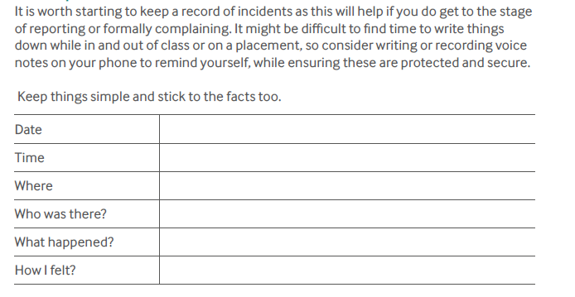

Recording and Reporting
1. Seek Support
2. Keep a record (factual, dates, who, when, where, what, how you felt)
3. Challenge behaviour (If possible, active bystander)
4. Report behaviour
EDI LEADS
SPEAK UP GUARDIANS
Notes:
Brief notes, anonymous and named reporting

Slide 22
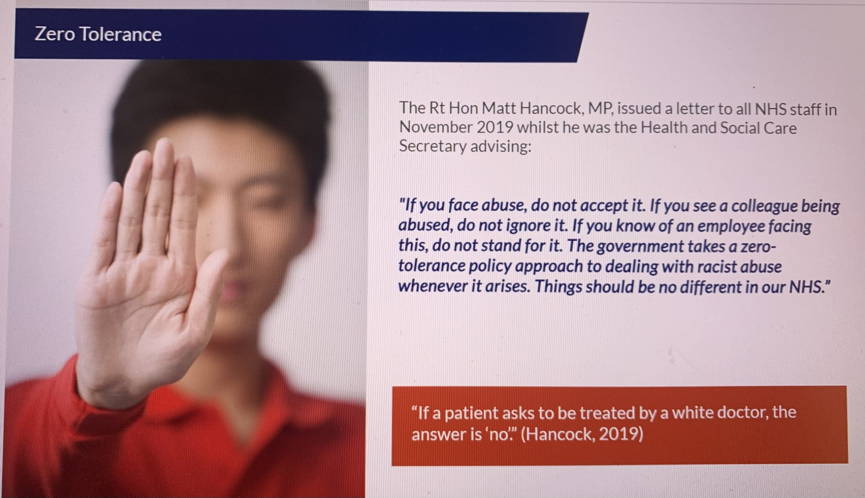
The Bottom Line is...
Notes:
Zero tolerance approach slide from the RCGP Allyship ELearning Module – a patient cannot request to see a non-white Dr

Slide 23
Glossary
Unconscious Bias prejudice in favour of or against one thing, person or group compared with another. It can manifest in how we judge and evaluate others, or how we act towards members of different groups. We all have bias and stereotypes we cannot avoid it.
Prejudice is pre-judgement about another person based on the social group(s) to which that person belongs. Consists of thoughts and feelings, including stereotypes, attitudes and generalizations that are based on little or no experience and then projected onto everyone from that group.
Discrimination is action based on prejudice. These actions include ignoring, exclusion, threats, ridicule, slander and violence. Discrimination may be personal maybe internalised racism/misogyny/colourism, interpersonal, When a racial group’s collective prejudice is backed by legal authority and institutional control it is transformed into institutional and structural racism. Racism is a structure, not an event.
Micro aggressions have been defined as brief and common daily verbal, behavioural, and environmental communications, whether intentional or unintentional, that transmit hostile, derogatory, or negative messages to a target person because they belong to a stigmatized group. Can result in othering, a sense of not belonging.
Notes:
Pairs or shout out or type into chat – discuss prejudice (as above attitude), bias (we all have these unconscious or not), discriminations and microaggression (actions)
All humans have bias/stereotypes we cannot avoid it. https://www.unconsciousbiasproject.org/resources/explain-unconscious-bias
Discrimination may be personal maybe internalised racism/misogyny/colourism, interpersonal, When a racial group’s collective prejudice is backed by legal authority and institutional control it is transformed into institutional and structural racism. Racism is a structure, not an event. It is not enough not to discriminate - we need to be anti-discriminatory and anti-racist.
Microaggressions - Common example where are you from? What’s the intention behind it? How do you determine the intention? Often subtle – acid rain/lots of little cuts – easier to spot overt racism
Sue DW, Capodilupo CM, Torino GC, Bucceri JM, Holder AM, Nadal KL, Esquilin M (2007). "Racial microaggressions in everyday life: implications for clinical practice". The American Psychologist. 62 (4): 271–86. doi:10.1037/0003-066x.62.4.271. PMID 17516773.

Slide 24
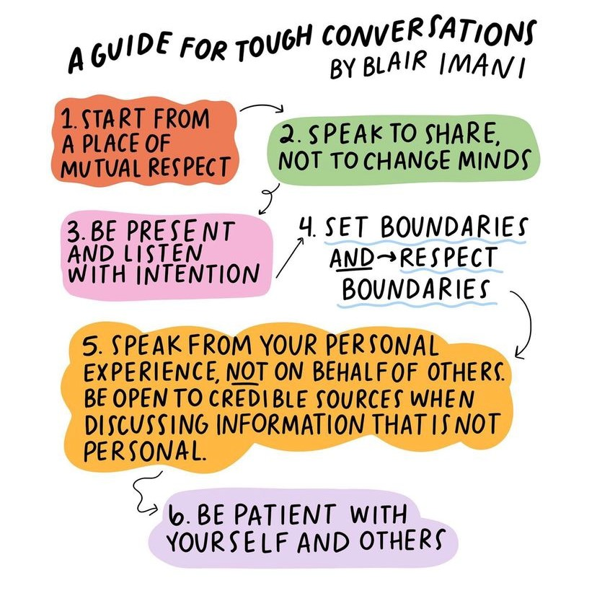
It is not enough not to discriminate - we need to be anti-discriminatory, anti-racist and allies
Summary & Evaluation
Notes:
My summary - It is not enough not to discriminate - we need to be anti-discriminatory and anti-racist.
What did you learn from this session?
What will you try yourself?

Slide 25
Further Reading and Resources
Burnham, J. (2013). Developments in Social GGRRAAACCEEESSS: visible-invisible, voiced-unvoiced. In I. Krause (Ed.), Cultural Reflexivity. London: Karnac
Podcast on Racial Discrimination in Primary Care with the WRES Team and Munir Adams
https://www.gmc-uk.org/education/standards-guidance-and-curricula/projects/differential-attainment
Woolf Katherine, Potts Henry W W, McManus I C. Ethnicity and academic performance in UK trained doctors and medical students: systematic review and meta-analysis BMJ 2011; 342 :d901
Jones, Alana C.; Nichols, Alana C. JD, MD; McNicholas, Carmel M. PhD; Stanford, Fatima C. MD, MPH, MPA Admissions Is Not Enough, Academic Medicine: November 3, 2020 - Volume Publish Ahead of Print - Issue - doi: 10.1097/ACM.0000000000003837
Follow Racial Equity Insights and Blair Imani on Instagram also the author of Read This to Get Smarter About Race, Class, Gender, Disability & More
Allyship RCGP E-Learning Module (30mins) - you don't need to be a member to access this

